Slide 1
AJAX

Slide 2

Agenda
Asynchronous web applications
Understand the interactions that are essential to asynchronous web pages
Understand the role of AJAX-style client side programming
Implement asynchronous servlets using the facilities of Java EE 6

Slide 3
AJAX
AJAX stands for Asynchronous Javascript and XML
It Incorporates
Standard based presentation technology using xhtml and css
Dynamic display and interaction using DOM
Data interchange and manipulation using XML and XSLT
Asynchronous data retrieval using XMLHttpRequest
And Javascript binding everything together

Slide 4
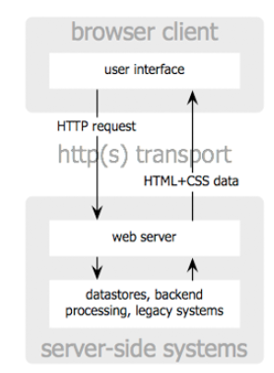
Classic Web Application

Slide 5
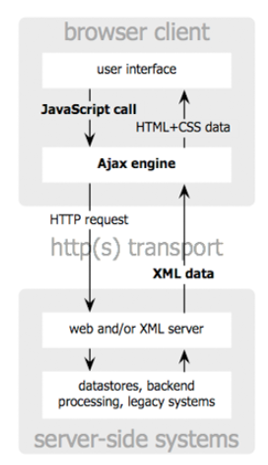
AJAX web application model

Slide 6
Asynchronous Support in JEE 6
Servlet 3.0 Specs has included asynchronous support
Annotation Attributes
@WebServlet(url="/foo" asyncSupported=true)
@WebFilter(url="/foo" asyncSupported=true)
Normal Servlet runs in a Synchronous Context
Asynchcronous Servlet run in a Asynchronous Context

Slide 7
Asynchronous Support in JEE 6
ServletRequest Methods
startAsync(ServletRequest, ServletResponse)
startAsync()
getAsyncContext()
Eg
AsyncContext aCtx= req.startAsync(req,res)

Slide 8
AsyncContext Class
AsyncContext class is a new Servlet 3.0
Provides the execution context for async operation
It wraps the request and response Objects
Methods
AsyncContext.dispatch()
AsyncContext.dispatch(path)
AsyncContext.dispatch(ServletContext,path)
Using any of the above methods enables the processing to return to the container after async operation that was started

Slide 9
AsyncContext Class
AsyncContext class is a new Servlet 3.0
Provides the execution context for async operation
It wraps the request and response Objects
Methods
AsyncContext.dispatch()
AsyncContext.dispatch(path)
AsyncContext.dispatch(ServletContext,path)
Using any of the above methods enables the processing to return to the container after async operation that was started

Slide 10
Async Servlet Example
<!DOCTYPE html PUBLIC "-//W3C//DTD HTML 4.01 Transitional//EN" "http://www.w3.org/TR/html4/loose.dtd"> <html> <head>
<meta http-equiv="Content-Type" content="text/html; charset=ISO-8859-1> <title>Asynchronous Servlet 3.0 Example</title> </head> <body> <h3>Hi this is a demo example of Asynchronous Servlet 3.0 Example.</h3> </body> </html> <!– asyncExample.html →

Slide 11
Async Servlet Example
import java.io.IOException; import java.util.Date; import java.io.PrintWriter; import javax.servlet.AsyncContext; import javax.servlet.ServletException; import javax.servlet.ServletRequest; import javax.servlet.annotation.WebServlet; import javax.servlet.http.HttpServlet; import javax.servlet.http.HttpServletRequest; import javax.servlet.http.HttpServletResponse; @WebServlet( urlPatterns = "/Servlet3AsyncExample“,asyncSupported=true)

Slide 12
Async Servlet Example
public class Servlet3AsyncExample extends HttpServlet{ public void doGet(HttpServletRequest request, HttpServletResponse response)throws ServletException, IOException{ Date date= new Date(); response.setContentType("text/html"); PrintWriter out= response.getWriter(); request.setAttribute("receivedAt", date); out.println(request.getAttribute("receivedAt")); AsyncContext asyncCtx = request.startAsync(); ServletRequest req = asyncCtx.getRequest(); boolean bol= req.isAsyncStarted(); //Will return true out.println("<br>AsyncStarted : "+bol);

Slide 13
Async Servlet Example
asyncCtx.dispatch("/asyncExample.html"); boolean bol1= req.isAsyncStarted(); //Will return false out.println("<br>AsyncStarted : "+bol1); boolean bol2= req.isAsyncSupported(); //Will return true out.println("<br>AsyncSupported : "+bol2); } public void doPost(HttpServletRequest request, HttpServletResponse response)throws ServletException, IOException { doGet(request, response); } }

Slide 14
Summary
AJAX comprises multiple Technology
AJAX is extensively used in WEB 2.0
AJAX is based on Standard technologies
AyncSupported servlet features enables us to process incoming request and response without being bound to original thread that initiated the request

